Slide 1
Meiosis Overview
Biology

Slide 2
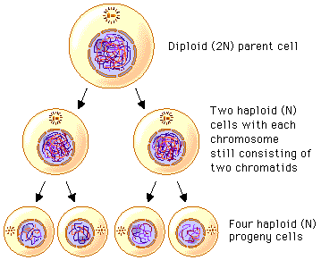
What is Meiosis?
Meiosis creates four new cells from one original cell
The new cells are used for reproduction – they are gametes (reproductive cells)
In mammals, gametes are eggs and sperm

Slide 3
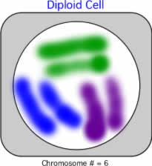

Vocabulary Details
Cells that have two different versions of each chromosome - one of Mom’s and one of Pop’s - are called “diploid”. (Like our original cell.)
Cells that have only one version of each chromosome are called “haploid”. (Like our four new cells.)

Slide 4
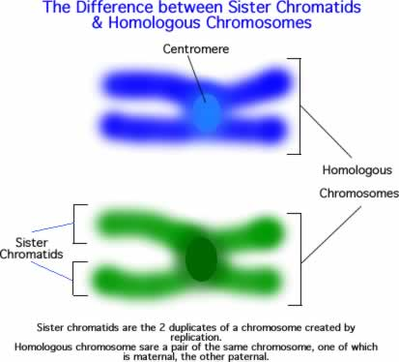
More Vocabulary
Sister chromatids are exact, identical copies of the same sequence of DNA
Homologous means two unique versions of the same chromosome – they have the same genes, but contain different information (hair color, for example…)

Slide 5
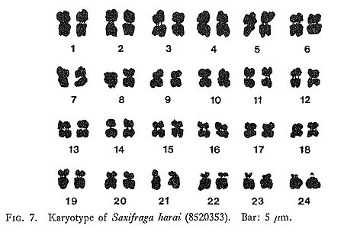
What Happens?
Meiosis only happens in organisms that reproduce sexually
Organisms have genetic material from both mom and pop
Half of the genetic info comes from mom and the other half comes from pop.
So every sexually-reproducing organism has two versions of each chromosome!

Slide 6
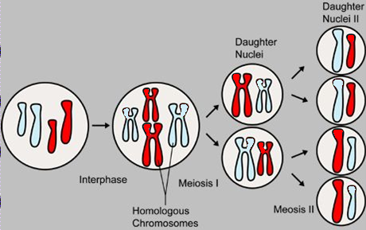
What Happens? (continued)
Before meiosis, The DNA is replicated.
two copies of Mom’s chromosomes and two copies of Pop’s chromosomes
During meiosis, each copy mix together (cross over) and are separated out and distributed into four new cells

Slide 7
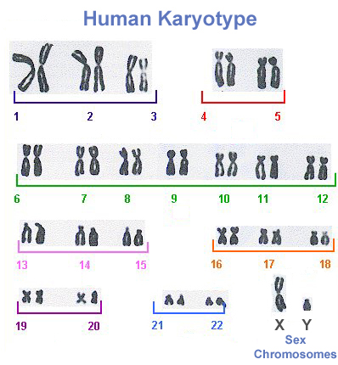
Important Points
Every chromosome can be identified as having come from either Mom or Pop
Humans have 23 different chromosomes, but are paired giving us a total of 46 – a set of 23 from mom and a set of 23 from dad.
Every chromosome can be identified by the specific genes they contain
For example, in humans, chromosome 1 has a gene that helps determine brain size – and chromosome 3 has a gene that helps determine blood type

Slide 8
The end result.
In animals meiosis produces the gametes, sperm in males and eggs in females.
In plants meiosis produces the spores (the reproductive cells in some plants).

Slide 9
Your Job
Make a detailed drawing of all the phases of mitosis.
Each phase should be titled and have the different parts labeled.
All parts should be big enough to be visible.
You may use any size paper and any coloring or writing utensils
You may work in groups of two, but each person has to have their own drawing.

